Slide 2
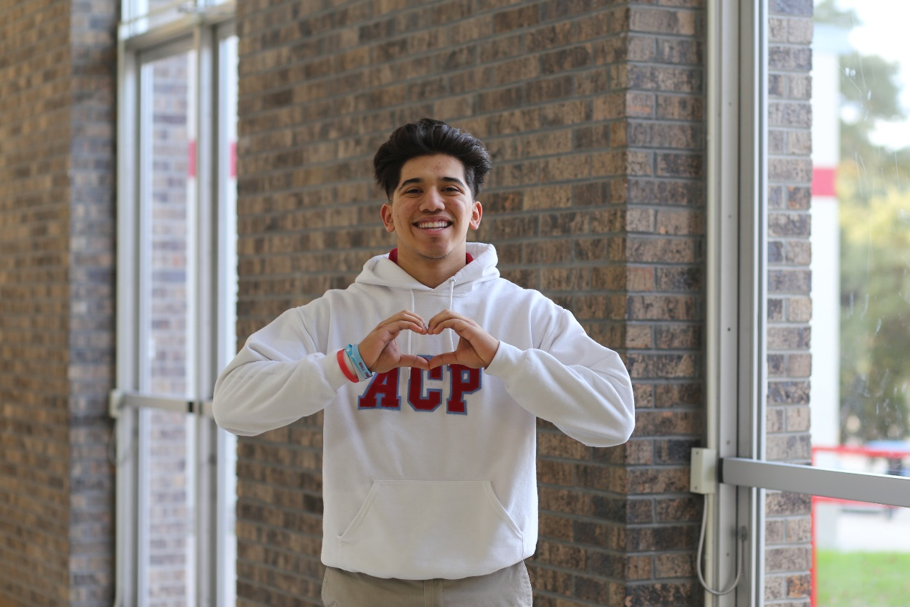
PURPOSE
Hope for the Future provides tuition assistance to financially disadvantaged families so their children can obtain the academic and spiritual benefits of a Catholic school education in the Archdiocese of San Antonio.

Slide 3
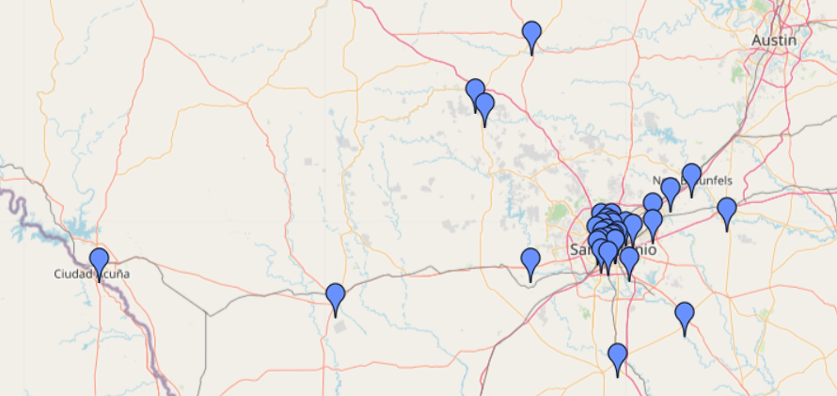
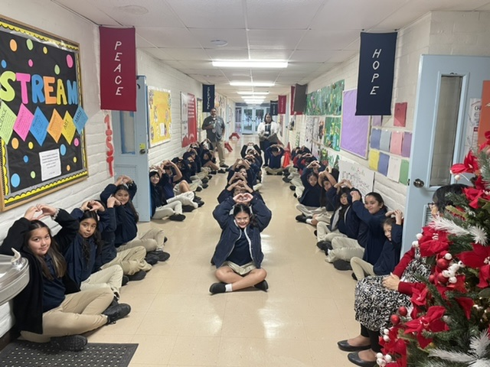
Serving STUDENTS at 35 Catholic Schools (27 Elementary and 8 High Schools)
Notes:
Geographic Diversity and diversity of need.
Certain funders favor certain schools or certain grades.

Slide 4
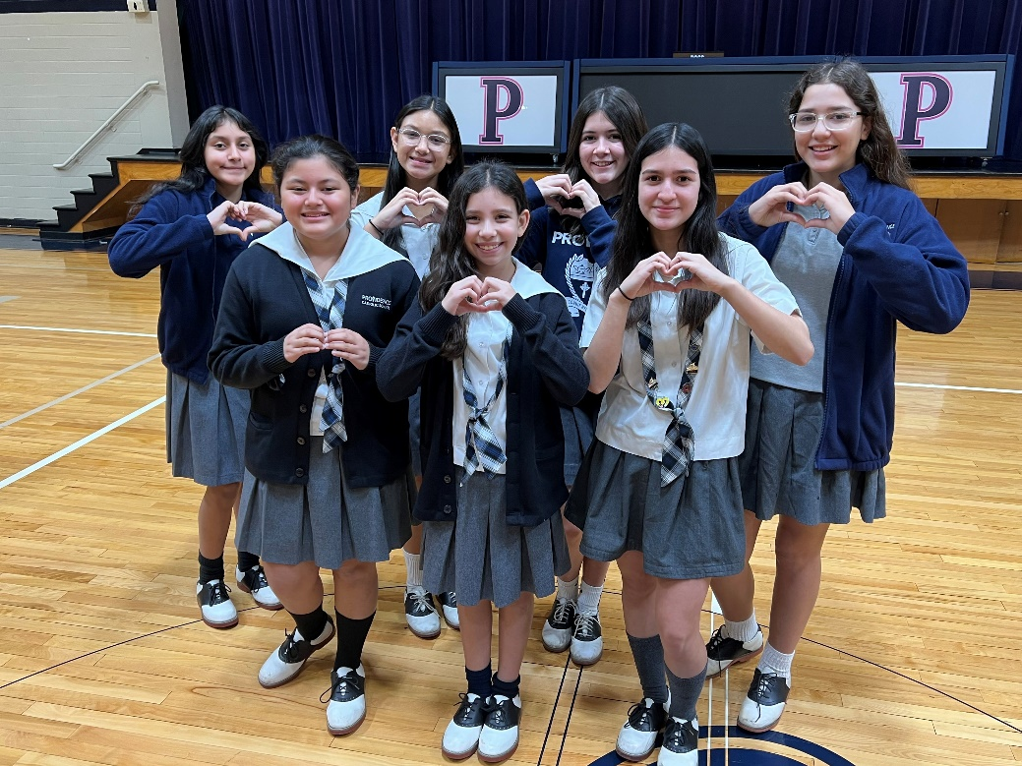
Impact of HOPE
Founded in 2006
Over $25 million in total awards
More than 20,000 total student awards
Most recent academic year 2022-2023
$2 million in tuition assistance
1,111 elementary school students
541 high school students
20% of ALL Catholic school students

Slide 5
The FAMILIES We Serve

Slide 6
Hope for the Future Sources of Revenue $2,470,000 for 2022-2023
Notes:
2021-22 $2.5 Million
Events $ 553,450 $ (91,063)
Parish/Mission Coll $ 144,877
Appeal $ 600,000
Gift/Donation $ 568,932
Grants $ 657,122
$ 2,524,381

Slide 7
Hope for the Future Award History
 | 2018-19 | 2019-20 | 2020-21 | 2021-22 | 2022-23
Student Applications | 3,384 | 3,006 | 2,816 | 2,516 | 2,485
Student Awards | 2,021 | 1,851 | 1,916 | 1,793 | 1,653
Percent of Applicants | 60% | 62% | 68% | 71% | 67%
Average Award | $916 | $882 | $760 | $942 | $1,215
Total Awarded | $ 1,850,558 | $1,631,936 | $1,455,876 | $1,689,750 | $2,077,126
Total Enrollment | 10,375 | 9,816 | 8,248 | 8,604 | 8,804
Percent of Enrollment | 19% | 19% | 23% | 21% | 19%

Slide 8
Tuition Award Trends & Enrollment
2018-19 to 2022-23
Applications are down by -27%
Students Awarded is down by -18%
Percent of Applicants Funded is up by 11%
Average award is up by 33% at $1,215
Total value of awards is up by 12%

Slide 9
2023-2024 Academic Year
Total approved funding $2,078,674
2,485 completed applications received
PRELIMINARY 1,571 students with finalized awards with more pending
Total funds awarded so far $1,798,956
$279,718 remaining with some reserve for emergency funding throughout the year.
Base awards for K-8 at $1,000
Base awards for High School at $1,500

