Slide 1



Slide 2
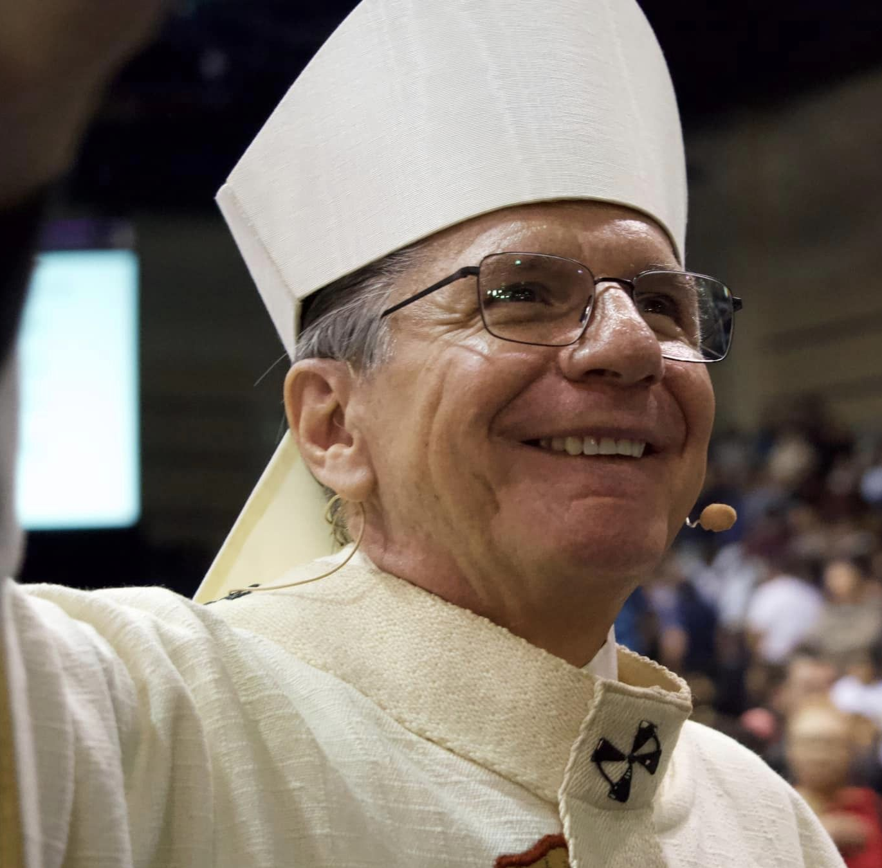
PRAYER
For a Successful Appeal
More Numerous than the stars in the sky are your blessings, O Good and Gracious God.
You have called us to walk with you by caring for others with our words and actions.
Strengthen our faith and open our hearts so that we may assist our brothers and sisters who walk alongside us.
Help us to comprehend the difference we can make, the love we can share and the lives we can bring to You.
We pray that your grace, O Lord, will lead us to be your loving heart and hands.
Amen.

Slide 3

1) What is the Archbishop’s Appeal for Ministries?
2) What programs are supported by the Appeal?
3) Who decided our parish goal?
4) Why give outside my parish?
QUESTIONS YOU
MIGHT ENCOUNTER

Slide 4

See all that WE can do!
The Archbishop’s Appeal for Ministries is a way that we, as one Catholic community, come together to provide the necessary ministries to those who would not otherwise receive those services.
Every gift is an act of discipleship and helps sustain the ongoing ministries of the Catholic Church in our archdiocese. From feeding the hungry, clothing the naked, visiting the sick and incarcerated to providing Catholic education and formation of our future priests and deacons.
Collaboration is our key to success!
Working together, the Archbishop’s Appeal for Ministries brings hope, love, and measurable differences to our Catholic Community.
We want to make it as easy as possible for you to have a successful appeal at the parish level. We will offer you a detailed timeline, customized materials, and turn-key instructions so that, as appeal coordinator, you will feel energized and not overwhelmed.
All parish goals are customized by an industry standard projection based on your church’s annual offertory.
It is not an obligation, but an opportunity to grow in our Catholic identity and to strengthen our community.

Slide 5
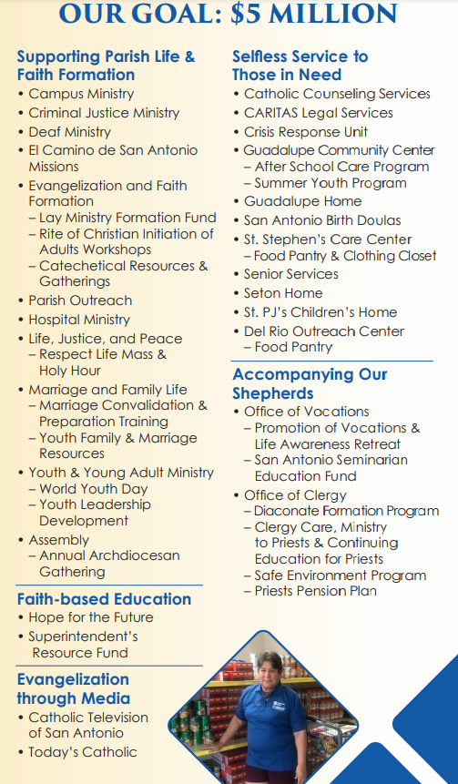
2024 Goal: $5 Million
We are 80% of the way there!
Where does it all Go?
The money that is raised in the Archbishop’s Annual Appeal for Ministries goes to FIVE different areas of our Catholic Community:
  Parish Life and Faith Formation
  Faith Based Education
  Evangelization through Media
  Selfless Service to Those in Need
  Accompaniment of our Shepherds

Slide 6

SEPTEMBER 21-22, 2024
IN-PEW WEEKEND
A letter from the Archdiocese will go out September 9 highlighting some key ministries that are supported by the appeal.
Hold your In-Pew Weekend September 21-22.
Start Promoting the In-Pew Weekend 2-3 weeks beforehand.
Social Media, Bulletin, Email, Posters, etc.
Put all materials in the pews and other areas prior to the weekend.
Have the homilist on September 21-22 speak about Stewardship and the Appeal.
Encourage parishioners to give to the appeal.
Include the Appeal in your Prayers of the Faithful and Verbal Mass Announcements for the duration of the campaign.
Notes:
Bad way – read letter Archbishop.

Slide 7

In Pew Collection & Lockbox Process
1. After Each In- Pew Weekend
  Keep all AAFM envelopes and donations separate from your Sunday offertory.
  DO NOT open, remove, or separate checks and cash from the in-pew envelopes.
    Count the envelopes and write the total on the transmittal form.
  Count and total all loose cash.
    Deposit the total cash to your parish account.
    Write a check in the total amount to Archbishop’s Appeal for Ministries
    List this amount as “anonymous cash” on the transmittal form.
  Include all envelopes, checks, and parish “anonymous cash” check with the transmittal
  form in the provided pre-printed LCI Tyvek envelope.
  Mail LCI Tyvek envelope to:
  Archdiocese of San Antonio
Archbishop’s Appeal for Ministries
PO Box 7374
Kensington, CT 06037-7374
2. DO NOT hold on to gifts and payments.
  Mail a bag at least ONCE per WEEK.
3. When in doubt, call us!! ZZ or Jenn are ready to help you!

Slide 8
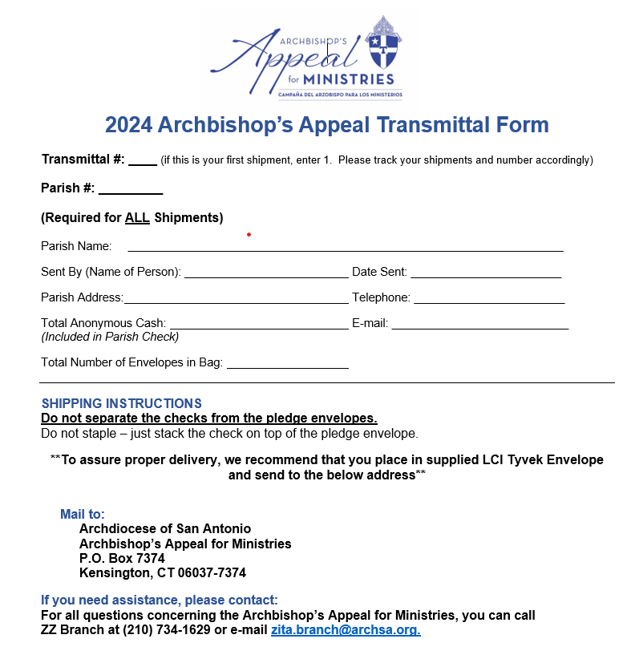
Transmittal Forms
This is an example of the LCI Transmittal Form. Please fill out one of these each time you mail an LCI Tyvek Envelope and include in your mailing.
This form helps us keep track of all donations and pledges.
You can find your Parish # on the
“Parish Resource Page” at:
https://archsa.org/archbishops-appeal/2024-appeal-campaign-resources/

Slide 9
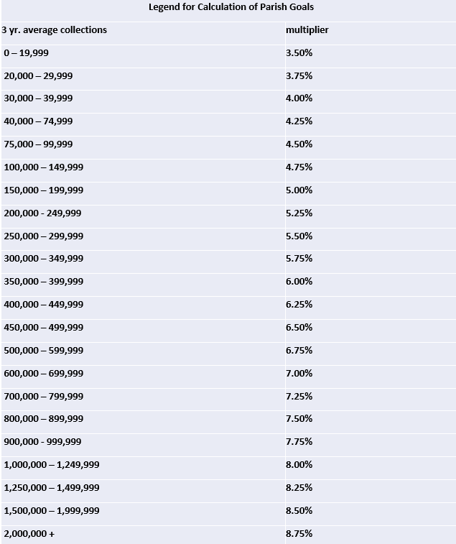

How is my Parish Goal Determined?
  How are parish goals calculated?
    Parish Goals are calculated using a sliding scale multiplier and the three-year average of your parish offertory.
    All parish goals are then adjusted equally (3%) to reflect a $5 Million archdiocesan goal.
Why did my parish goal change?
    Your parish offertory three-year average changed thus changing your multiplier.
What happens if my parish reaches or exceeds goal?
    Yay! You get a social media post of congratulations!
    You may receive a parish rebate.
      50% of all funds collected over goal will be returned to the parish as a rebate.
      An additional $1000 will be rebated should the parish increase the number of donors by 20% over last year.
    Recognition at the annual AAFM appreciation Mass.
Notes:
How are parish goals calculated?
Parish Goals are calculated using a sliding scale multiplier and the three-year average of your parish offertory.
All parish goals are then adjusted equally (3%) to reflect a $5Million archdiocesan goal.
Why did my parish goal change?
Your parish offertory three-year average changed thus changing your multiplier.
What happens if my parish reaches or exceeds goal?
Yay! You get a social media post of congratulations!
You may receive a parish rebate.
50% of all funds collected over goal will be returned to the parish as a rebate.
An additional $1000 will be rebated should the parish increase the number of donors by 20%
Recognition at the annual AAFM appreciation Mass.
Legend for Calculation of Parish Goals
3 yr. average collections
multiplier
0 – 19,999
3.50%
20,000 – 29,999
3.75%
30,000 – 39,999
4.00%
40,000 – 74,999
4.25%
75,000 – 99,999
4.50%
100,000 – 149,999
4.75%
150,000 – 199,999
5.00%
200,000 - 249,999
5.25%
250,000 – 299,999
5.50%
300,000 – 349,999
5.75%
350,000 – 399,999
6.00%
400,000 – 449,999
6.25%
450,000 – 499,999
6.50%
500,000 – 599,999
6.75%
600,000 – 699,999
7.00%
700,000 – 799,999
7.25%
800,000 – 899,999
7.50%
900,000 - 999,999
7.75%
1,000,000 – 1,249,999
8.00%
1,250,000 – 1,499,999
8.25%
1,500,000 – 1,999,999
8.50%
2,000,000 +
8.75%

Slide 10


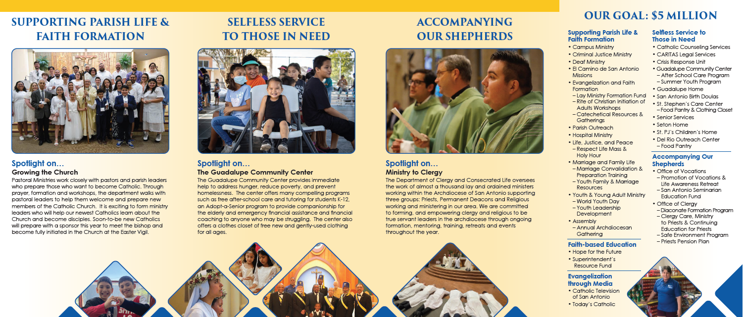
Materials Examples 1
Poster
Brochure – Page 1
Brochure – Page 2

Slide 11
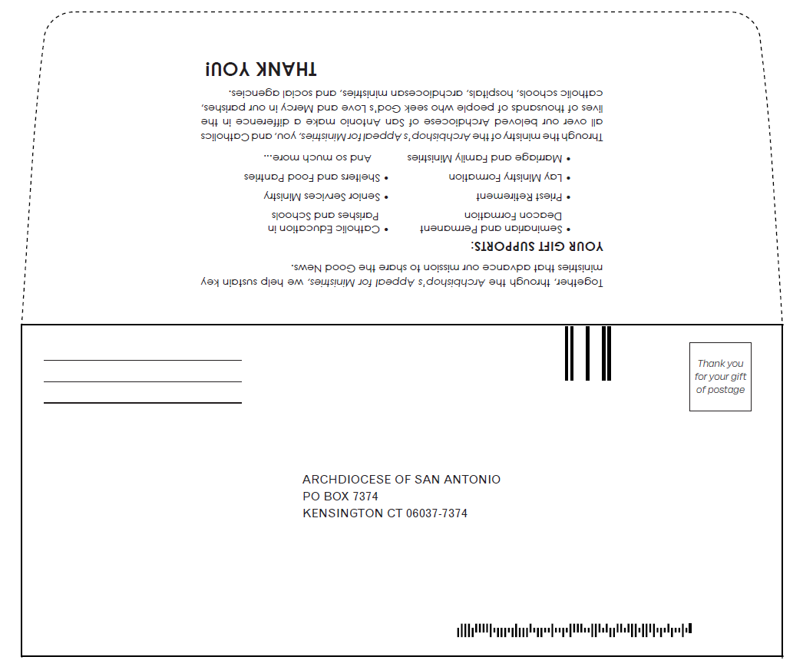
Materials Examples 2
Transmittal Forms
In-Pew Envelopes

Slide 12



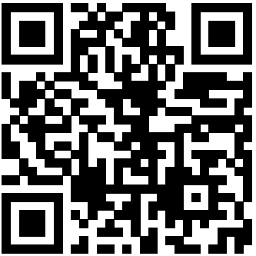
Appeal materials can be found on the appeal web site at: https://archsa.org/archbishops-appeal/2024-appeal-campaign-resources/
Social Media, Bulletin, Email
#AAFM
#WalkingUnitedinChrist

Slide 13

IMPORTANT CONTACTS
Appeal inquiries and parish reports: appeal@archsa.org or (210) 734-1910
Director of Development
Jennifer Rodriguez jennifer.rodriguez@archsa.org
Associate Director of Development
ZZ Branch zita.branch@archsa.org
OFFICE OF STEWARDSHIP AND DEVELOPMENT
We are here to help you!
Have questions? Need additional Materials?
Need customized graphics or help with communications?

