Slide 1
PASTORAL VISION
ARCHDIOCESE OF SAN ANTONIO
Notes:
Thank you everyone, lets get started with our next session. We are going to practice your role in assisting the pastor in the pastoral planning activity of your parish. To be able to do that, we need to have an established pastoral vision. Some of you may already have one, which is great. Can I get a show of hands if your parish already does have a pastoral vision? Mission statement? Priorities? Goals? Some yes, some no. That's ok! If you do already, hopefully our sessions affirm your vision. If you don't, this should be a great start.
The pastoral vision for your parish, just like the pastoral vision for our diocese and the global church, should not only paint the picture for where the Holy Spirit is calling us, but also explain why we do what we do. It should be the reasons behind all of the decisions we make.

Slide 2
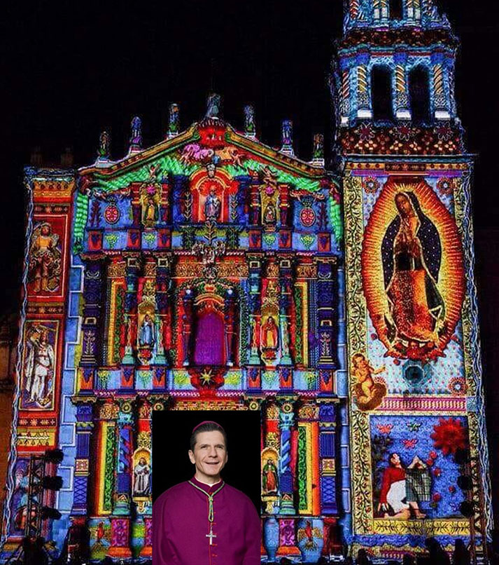
History Lesson
New Bishop, New Vision
Archbishop arrived; traveled around ArchSA, listening to the faithful
2013
2010
Archdiocesan Mission, Sacred Purpose, Vision, Goals and priorities are proclaimed
‹#›
2
Notes:
Like it was mentioned at the beginning of the day, your pastoral vision as a parish should flow from the pastoral vision of the Archdiocese, just like the vision of the Archdiocese should flow from the vision of the United States Catholic Conference of Bishops and the Vatican. So I'm going to give you a high overview of the last 14 years and how it has shaped and formed our pastoral vision for the diocese.
When Archbishop first arrived, instead of creating his own plan for what he wanted to do with the archdiocese, he conducted an investigation across all 19 counties. He visited every parish community, back then 176 parishes and missions, and held 25 listening sessions. He then gathered his leadership team and some experts together based on their gifts, strengths, and experiences to reflect on the findings. From those findings came what we have as part of our mutually shared vision: our sacred purpose, our pastoral priorities, and core values, which were proclaimed at Pentecost in 2013.

Slide 3
Our Sacred Purpose
“Seeking to live in sacramental communion with one another, the Archdiocese of San Antonio exists to make disciples and missionaries of Jesus Christ to prepare for the promise of Eternal Life.”
PRIORITIES
The New Evangelization
Catechesis &
Faith Formation
Youth &
Young Adults
Notes:
This is our pastoral vision: The Archdiocese of San Antonio exists to make disciples and missionaries of Jesus Christ to prepare for the promise of Eternal Life.
Everything that we do as a diocese, every celebration, every liturgy, every event, every decision has this purpose as a foundation. It also reminds us of the great commission Jesus gave us at the end of Matthew's gospel, which is how we should live out our daily lives. There were 3 specific areas in which we wanted to live out our sacred purpose. They were repeatedly evident in every deanery and were identified during the Archbishops investigation.
They were the New Evangelization, Catechesis and Faith Formation, and Youth and Young adults.
After its proclamation in 2013, over the next 8 years the diocese recommended that parishes do the same thing: look at their individual parish reality and create goals based on the 3 pastoral priorities which fell under these three areas. Anyone here remember that process or participate in it?

Slide 4
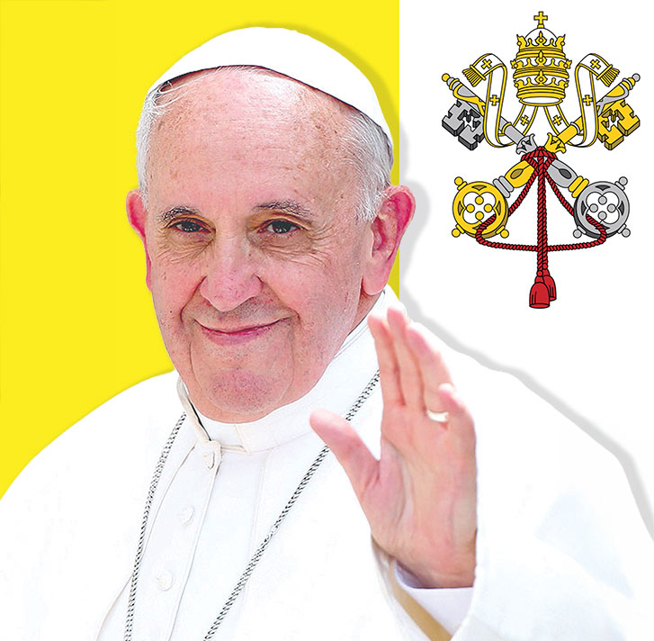
History Lesson
Worldwide & U.S. Invitation
Pope Francis' call for synodality
2022
2021
USCCB National Eucharistic Revival
Notes:
Fast forward to 2021, Pope Francis called the entire church to engage in the synod on synodality. All were invited to listen to one another to hear the promptings of the Holy Spirit and discern the next steps forward in journeying together. The Pope was investigating and reflecting on responses happening over the globe, and asking that the rest of the church follow suit. Each parish in the diocese was asked to appoint a synodal representative or team to lead organized listening sessions and discuss two fundamental questions. Parishes were asked to submit their findings to the archdiocese, who submitted them to the Vatican, but also to reflect on to content collected during the conversations. The synod on synodality will conclude this October.
In 2022, the US Conference of Bishops called for a National Eucharistic Revival, a need to jumpstart our belief in the Jesus's presence in the Eucharist; a recommendation after reflecting on some very disturbing data.

Slide 5
Pew Research Center
Nearly 7 in 10 Catholics (69%) say they personally believe...the bread and wine used in communion “are symbols of the body and blood of Jesus Christ.”
Pew survey conducted Feb 4-19, 2019 among U.S. adults.
Notes:
According to a survey conducted in Feb. 2019, 69% of Catholics don't believe in the True Presence of Jesus in the Eucharist. They believe it is a symbol. Only 28% of those Catholics believe the Church's teaching on transubstantiation. Transubstantiation--the term for when the bread and wine are changed into the body and blood of Christ, while visibly remaining the same.
More over, more than 30% of Catholics have not returned to the pews post-pandemic and in the past decade, more than 40% of millennials now identify as “unaffiliated” with any religion, they have...none. Many young Catholics find the faith to be irrelevant to the meaning of their lives and challenges.
These are some disturbing facts that are the results of investigating. As a result, the US Conference of bishops called for a Eucharistic Revival.

Slide 6
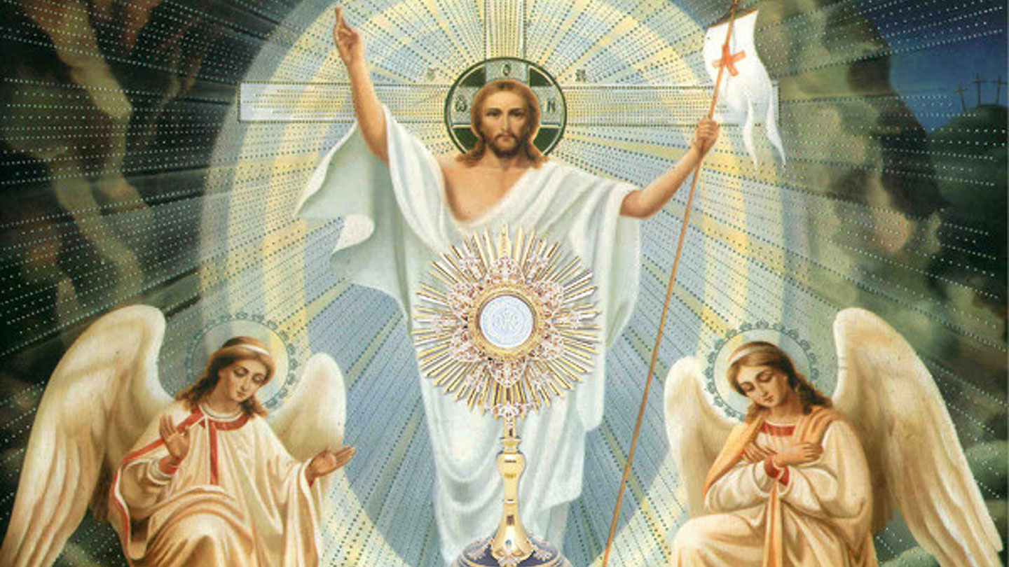
Notes:
The National Eucharistic Revival was a 3 year plan designed to do 4 main things: reinvigorate our liturgies, form people, help them have an encounter with the Lord in the Eucharist, and then send them out to evangelize as missionary disciples. Across the archdiocese, parishes had teaching Masses, Advent Mission talks on the Eucharist, and when we had the Assembly last year, we asked parishes to host a Friday night event centered around the Eucharist.
Anyone want to share what your parish did this past year?
While the National Eucharistic Revival and the Synod on Synodality have an advertised end, our diocese plans to continue living in this spirit, as we have adopted this as our way of being. This isn't the last time you'll hear about these things. We talked earlier about how as a Pastoral Council, you are a synodal structure, a synodal body.
Now looking forward, we'll be celebrating our 150th anniversary as a diocese this year, next year is the Jubilee year for our Global church, and then the following year is the 125th anniversary of us being designated as an archdiocese. So you'll see things over the next couple of years in line with those as well.

Slide 7
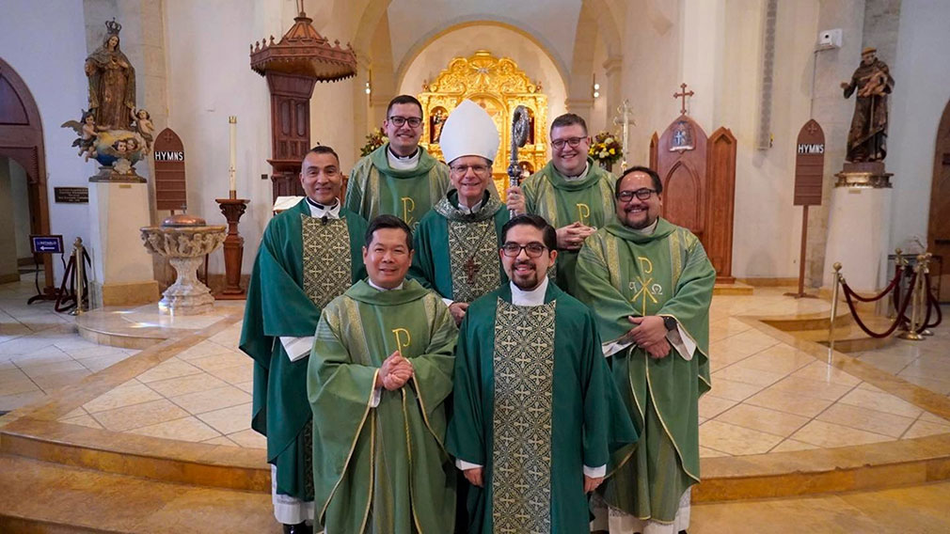
Your Pastoral Vision
Notes:
Hopefully you were able to hear how our local church is connected to the national church and global church, how the vision flows from the global church down to our local church, and how at multiple stages we've engaged in this process that we talked about earlier: investigate, reflect, and recommend.
Any questions so far? Now that you have this understanding of the Archdiocesan pastoral vision, lets start talking about your vision as a parish. In the same way that our sacred purpose as an archdiocese is to make missionary disciples, that is the same purpose that every single church, ever established, has. That's the great commission we've been given. That's the reason that on your parish script, your purpose is already filled in for you. We all have the same sacred purpose. We are all called to make missionary disciples. How each individual parish community is called to fulfill that great commission is unique. No two parishes are the same, no two communities are the same, and so how they fulfill the great commission isn't going to look the same either.
So today we aren't going to have time for you to really wordsmith your own vision statement. Instead, what we are going to do is build the framework for your pastoral vision. The first step in doing that is discerning who your parish is called to serve. Why would we identify who your parish serves? Because it bases our vision in the reality of our parish. Identifying WHO we are called to serve will allow us to better discern a vision and plan on HOW we are called to serve them. It allows us to dream better. Just like the Archbishop conducted 25 listening sessions to identify the areas of need in the diocese, your council will have an opportunity to reflect on and identify the people and the needs in your specific parish community. A parish vision gives better direction and a framework to make your parish goals and purpose become a reality. Proverbs 29:18 says without a vision the people parish, but happy is the one who follows instruction.
Again, some of you already have a vision, which is great! This exercise we are about to do should help evaluate if your parish vision is still relevant or if it needs to be tweaked.

Slide 8
PARISH VISIONING EXERCISE
Thoughts to consider:
Who is around and outside your parish?
What is the greater mission of the church?
How do you plan to accomplish that mission?
Notes:
Again, I'm going to invite Ademola up to lead us through this exercise.
We are going to use the same process we used last time. I'll give you 2 mins for individual reflection, we will go around the table and allow everyone a chance to share, we will go around again and give everyone a chance to respond, and then we will open it up for further discussion. We will do this for each question.
As we go through this exercise, I want you to keep a few key points in mind as you focus on your parish community.
As a pastoral council, the pastor may want to consult you to investigate a specific request he has. Your experience with other community members, specific ministry groups, your involvement both in and outside the parish, will help you to prayerfully reflect on how best to provide a recommendation to him. As you focus on the questions we will walk thru, I want you to consider the following questions.
*read the 3 questions*

Slide 9
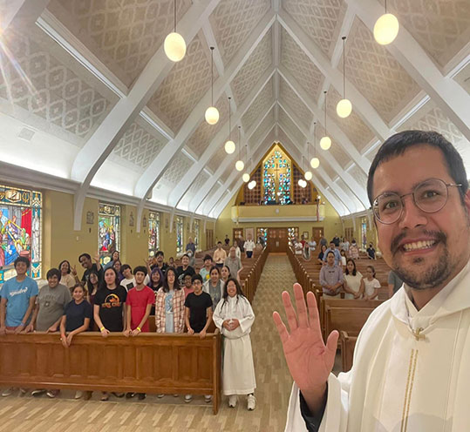
PARISH VISIONING EXERCISE
Who does your parish serve?
Young families? Elderly couples? Migrants? Retired adults? Seasonal visitors?
Notes:
So first question: Who does your parish serve?
Your first temptation may be to put "everyone." And what that is assumed, it's not a good answer! I really want you to describe your definition of everyone. How well do you know your community??
How would you categorize them? What do you know about them?
What are some of the professions in your parish community?
Are they business owners, school teachers, college students? Are they parents? Elderly or empty nesters?
What are some of the specialized ministry groups in your parish?
How would you describe the cultural make-up of your parish?
Who are some of the social groups that stand out in the community?
What are some of the businesses surrounding your parish? Is there a school? A prison? A hospital? A nursing home?
Are you in a neighborhood or near an apartment complex? Does your parish community live within the parish boundaries?
Remember that your parish is also responsible for ALL the soul's that fall within the parish boundary.
Think about who they are.
To help you with this question, let's look at our sample parish, St. Boniface. They serve:
Farmers, ranchers, truck-drivers, business owners, and educators
Even mix of Anglo and Hispanic families w/3+ kids
Growing Spanish-only speaking population
Various Christian denominations
Mid-size commuter population
New subdivisions for incoming families
Youth and YAs often leave for higher edu or work opportunities
Athletics, FFA, and rodeo enthusiasts
Large senior population
Now lets take some time to individually reflect and write your notes. Put them on the "Who" side of your large paper. Allow some time for personal reflection.
Talk about who your parish serves. Remember to include everyone in the discussion and then ask yourselves, is EVERYONE represented?
When you have everyone represented, put those sticky notes on your butcher paper on the correct side.
Moving forward, when your parish creates programs or makes decisions, you have an accurate reflection of who will be impacted.

Slide 10
Prayer Warriors
All are Welcome
Team Players
Low-to-wealthy income families
English & Spanish speaking families
Many w/high school, higher education degrees & certs
Mid-size homeless population
10 + ministry groups
Many young families, singles, elderly, divorced, young adults, college students, migrants and immigrants
Notes:
Urban parish script
Ok, now if you haven't yet, take time to fill out your ministry script. You should be able to make direct correlations between your vision statements and your community statements.

Slide 11
Prayer Warriors
All are Welcome
Team Players
Farmers, oilfield workers
Polish & Hispanic families w/3+ kids
Growing Spanish speaking population
Various Christian denominations
Mid-size commuter population
New subdivisions for incoming families
Youth and YAs often leave for higher edu or work opportunities
Athletics, FFA, and rodeo enthusiasts
Large senior population
Notes:
Rural
Ok, now if you haven't yet, take time to fill out your ministry script. You should be able to make direct correlations between your vision statements and your community statements.

Slide 12
PARISH VISIONING EXERCISE
If your parish were able to do everything possible, with no limitation on time, energy or resources, what would it look like?
If we had everything we needed, who could we be? What could we do?
Notes:
This question is a little more meaty but should also allow you to dream a little bit.
Keeping in mind the people you just identified, here's the second question: If your parish were able to do everything possible, with no limitation on time, energy or resources, what would it look like?
Now the last workshop we did, we had someone write heaven on earth. While that is also a great and desired idea, the main idea is to get you to dream without thinking about all the steps it will take to get there. It's easy to get stuck in excuses of why we can't make something happen and block the power of the Holy Spirit. Pastors, we know that you also have some ideas, so I'm counting on you to provide some great examples.
Let's check out St. Boniface...for examples of what they would like to do with who they've identified:
Vibrant youth ministry
Youth are excited about the faith, invite friends to Mass, and continue lifelong discipleship after leaving home
All ages feel welcomed and integrated
Parish diversity is embraced and celebrated among generations, cultures and languages
Existing parish ministries are integrated and thriving in the community
Faith extends beyond the parish
Online RCIA classes for farmers & truck drivers
Vibrant evangelization ministry
Different faiths collab & comm regularly to address larger community issues
Please note that your vision should reflect the reality of who your parish serves and what is a feasible and realistic. Now it's your turn.
If your parish were able to do everything possible, with no limitation on time, energy or resources, what would it look like?

Slide 13
Prayer Warriors
All are Welcome
Team Players
Low-to-wealthy income families
English and Spanish speaking families
Many w/high school, higher education degrees & certs
Mid-size homeless population
10 + ministry groups
Many young families, singles, elderly, divorced, young adults, college students, migrants and immigrants
Unified community among English & Spanish speaking families
Harmony & collaboration between ministry groups
Parish offers diverse FF that caters to different edu levels
Ministries offer something for everyone in abundance
Excellent comm & relationship between staff & ministry leaders
Evangelization is a part of EVERYTHING
Marginalized communities feel welcomed
Notes:
Urban parish script
Ok, now if you haven't yet, take time to fill out your ministry script. You should be able to make direct correlations between your vision statements and your community statements.

Slide 14
Prayer Warriors
All are Welcome
Team Players
Farmers, oilfield workers
Polish & Hispanic families w/3+ kids
Growing Spanish speaking population
Various Christian denominations
Mid-size commuter population
New subdivisions for incoming families
Youth and YAs often leave for higher edu or work opportunities
Athletics, FFA, and rodeo enthusiasts
Large senior population
Vibrant youth ministry
Youth are excited about the faith, invite friends to Mass, and continue lifelong discipleship after leaving home
Intergenerational ministry mentorship
Parish diversity is embraced and celebrated among generations and cultures
Existing parish ministries are integrated and thriving in the community
Faith extends beyond the parish
Online RCIA classes for farmers & oilfield workers
Vibrant evangelization ministry
Different faiths collab & comm regularly to address larger community issues
Notes:
Rural
Ok, now if you haven't yet, take time to fill out your ministry script. You should be able to make direct correlations between your vision statements and your community statements.

Slide 15
NEXT STEPS
Notes:
Thank you all for participating in this brief exercise to start the visioning process. The goal for this session was to get clear on who your parish serves and the possibilities of what you could do if you had unlimited resources, time, etc. Sometimes we need a little help looking past the daily challenges and making room for the Holy Spirit to move.
The next step would be for you all to prayerfully reflect on where this information is calling you to move, grow or act. Finish the vision statement. Create a brief mission statement.
What could your vision be based on who is in your community and who attends your parish? How will your parish specifically be missionary disciples and glorify Christ by your lives?
We have a minute or two left; does anyone want to share one major takeaway?

