Slide 1
PASTORAL COUNCILS ​
ROLE AND FUNCTION
Notes:
Ok, so that survey was pretty good! Thank y’all for participating, the whole purpose of it was to see, generally, where everyone was at. So whether you’re doing great and answered “always” for every question, or maybe you recognize that your council has room for growth, we want refocus everyone on what the role and function of a pastoral council should be. This isn’t a time to finger point or to tell anyone they’re doing a bad job as a council, this is an opportunity, regardless of where we’re at, to grow together to where we should be.
​Besides the home where we grew up, the parish is where we learn to live as disciples of the Lord. It is where we learn about and experience communion with the universal Church. The parish is the community which makes real and present the mystery of the Church in a visible, immediate and everyday form. ​It is where we get to see the body of Christ in a tangible way. Every parish across the world is meant to do this.
But you know that running a parish is a lot of work, right, and your pastor is responsible for guiding and overseeing all of that, but he doesn’t do all that work alone. He CAN’T do it all alone, that would be impossible. He has parish staff, volunteers, and different groups carrying out ministries of all kinds, and he has the finance and pastoral councils to share in the pastor’s ministry of leadership. Pastors want and need the help of their parishioners. This past summer we did a survey of our priests and one of the main findings was that 40% said they were too busy to pray as much as they would like or to meet the ministry needs of their people.
That's not healthy, we can't function as a Church in a sustainable way like that.

Slide 2
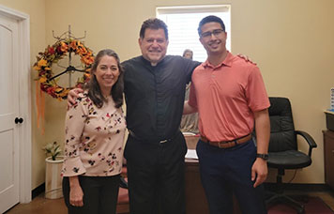
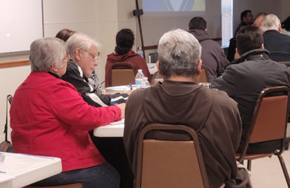
New Way
HIERARCHY
The gift of the Holy Spirit, which is one and the same in all who have been baptized, is manifested in many forms.
Old Way
Notes:
A pastoral council is composed of members of the parish who form one body with the pastor.​ You’re probably thinking, well “duh”, but I was talking to a pastor last year whose chairman, the CHAIRMAN, wasn’t attending mass or involved in any ministries outside of the council. For all intents and purposes, the pastor had a chairman who wasn’t an actual member of the church! Its hard to consult your pastor about a community if you’re not actually part of that community, right? Since it is the PASTOR’s council, the council shouldn’t meet or function without him unless the pastor has permitted that for a particular reason. The whole reason the council exists is to consult the pastor and assist him in pastoral planning so the parish can carry out its mission, whether that’s short-term planning (like 3-6 months) or long-term planning (3-5 years).
​When your pastor consults you, he is sharing responsibility for the parish. He's giving you a share in his ministry of leadership. By our baptism we are incorporated into the Body of Christ, made sharers in her mission and receive the gifts of the Holy Spirit. It is this understanding of baptism that makes it obvious that God’s truth, which provides the guidance for the Church, comes not only through the clergy and hierarchy (which is how we used to think about things), but also through the people. In order for the Church to have the fullness of God’s light and guidance, the people must be consulted, the people must share in the responsibility.
Out of the documents of Vatican II, a completely new ministry of the People of God was born – a special ministry of people and pastor together reflecting on the parish’s ministerial activity, and on the basis of that shared reflection, discussing and discerning together what needs to be developed and planned in the parish to carry out its mission and all that God is calling the parish to accomplish. That is the ministry that you have been called into. That’s the ministry that you said yes to, whether you realized it or not. This is the ministry that is specifically and particularly the ministry of the parish pastoral council.

Slide 3
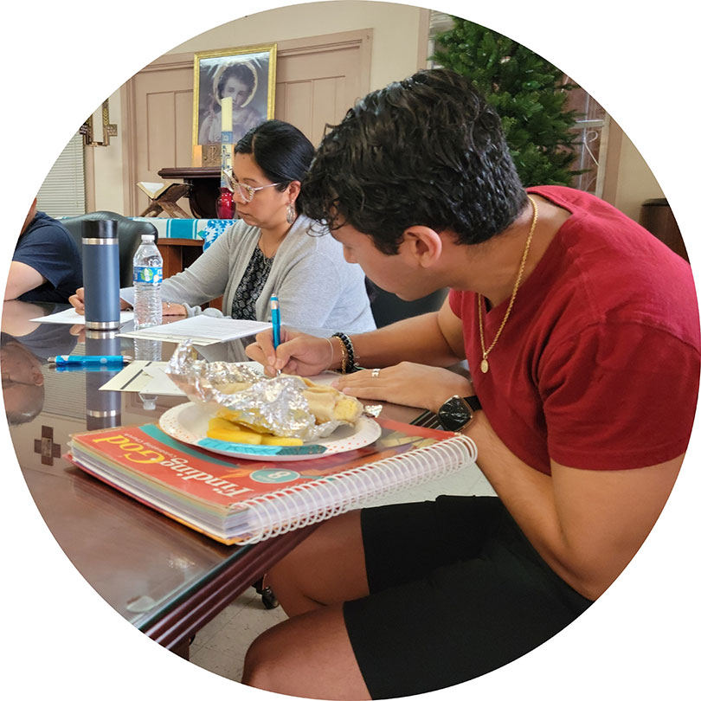
CO-RESPONSIBILITY
Spiritual Growth, Physical Growth, & Apostolic Activity
They must no longer be viewed as "collaborators" of the clergy but truly recognized as "co-responsible", for the Church's being and action, thereby fostering the consolidation of a mature and committed laity.
-Pope Benedict XVI
Notes:
I love this quote from Pope Benedict XVI, he wrote a whole document on the Co-Responsibility of the Laity that I would encourage you to check out. He said this, "They must no longer be viewed as "collaborators" of the clergy but truly recognized as "co-responsible", for the Church's being and action, thereby fostering the consolidation of a mature and committed laity." This shared responsibility, this co-responsibility, of the clergy and laity for the mission of the Church requires a change in mind-set.
Father, which souls are you responsible for in your parish boundaries? Allow time to answer. All of them. Not just the parishioners. Not just the Catholics. Not just the Christians, but all the souls. Everyone. Your pastor is spiritually responsible for everyone in your parish boundaries, and you, by nature of your baptism and role on the pastoral council, are co-responsible for every soul in your boundary.

Slide 4
3 Areas of Focus
Apostolic Activity
Physical Growth
Spiritual Growth
Notes:
You, as a pastoral council, are called to care for them by focusing your efforts on 3 main areas: the spiritual growth, the physical growth, and the apostolic activity of your community.​
Spiritual growth and well-being: you are responsible for planning pastoral activity that leads to people growing in the faith, whether that’s through ministries, faith formation, retreats, Lenten/advent missions, bible studies, men’s/women's groups, marriage formation, discerning the best mass times, collaborating on confirmation celebrations and reconciliation services.
​Physical growth and well-being: Understanding what's needed to carry out the mission of the church and to provide the support for those needs. material assets, responsible use monies, what you do with the money, the projects that you choose to carry out, caring for the physical assets that help you carry out your ministry.​ Maybe you realize that you have a bunch of youth at your parish but don’t have a space for them to meet, or maybe you have a lot of elderly, but your facilities make it hard for them to maneuver around. Or maybe you realize that the first place someone goes to find out about your church is Google, but you don’t have a website.
​Apostolic Activity: This is the point of the other two. Our physical and spiritual growth should lead to greater apostolic activity in our parish. They should lead to more opportunities of us putting our faith in action! So, all those ways that the parish reaches out to its parishioners and non-parishioners to evangelize and care for the actual physical and spiritual needs of the people in their territory (food pantry, communion to the homebound, etc.). Most parishes have money available for people who are in immediate need for those that are about to have their water shut off or go to the grocery store, participating in ecumenical activity or setting up an ecumenical alliance with other denominations in the area, holding prayer services after the tragedy involved everyone in the community, participating in service projects for the greater community.
These are the 3 areas you are primarily responsible for.
​

Slide 5
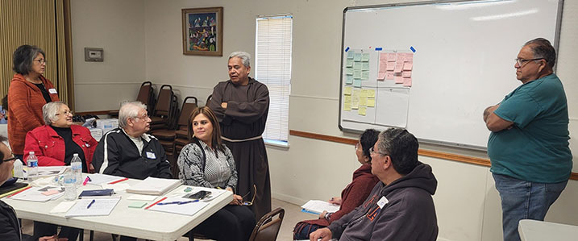
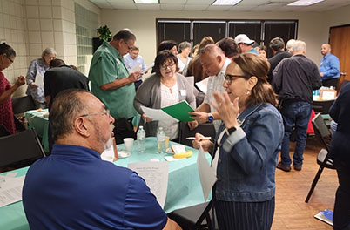
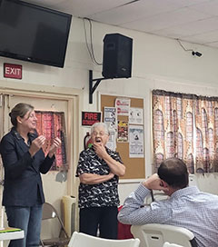
NATURE
Consultative
Councils must not act independently of the pastor
Notes:
You do that by consulting your pastor.
I want to make this very clear: while you share in your pastor’s responsibility, he is the one who is ultimately responsible for the decision at the parish-level. He gives the final say-so, he gives the final approval and signs off on everything.
This isn’t to minimize your role as a council, but to clarify it: you consult him. You give him advice on the areas we just talked about, on the mission and vision of the parish, the short-term and long-term plan. Your pastor can’t be everywhere, with everyone, can't tend to everything. Its impossible. That’s why you’re necessary. You’re able to listen, to “read the signs of the times”, to be among the people in such a way that you truly know what’s going on in your community (not just in your parish), the needs and issues, so that you can consult him on the direction of your community.
The essential work of a pastoral council is to participate with the pastor and pastoral leaders in thinking about and praying about these issues and needs, and planning for a way to address them as a community.
We have this model at basically all levels of the church. Pope has college of cardinals, synod of bishops, he calls special synods together from time to time (with youth, married couples, etc.). At the diocesan level, Archbishop has the presbyteral council made up of priests from every geographical region of the diocese, the college of consultors, the archdiocesan finance council and the APC.
To do this well, to be able to consult and offer your pastor sound advice, there’s a process that we recommend going through.

Slide 6
THE METHOD
Pastor can bring an issue to the council.
The council can bring issues to the pastor.
Involved in short-term and long-term pastoral planning
Investigate
Reflect
Recommend
Notes:
This is how you should function. Whether it is the pastor bringing an issue to the council that he wants your guidance on, the council bringing an issue to the pastor, or whether you’re doing short- or long-term planning, these are the 3 steps you should follow.
Dialogue​, reflection, prayer and discernment are at the center, at the heart of this process.
Investigate: is researching and educating the council on the issues and needs. This can look differently depending on the situation, but requires relying on the gifts you have within your council and parish, relying on trusted resources (from the diocese, Vatican, etc.), or setting up an ad-hoc committee or tasking an individual to carry out this work and bring the findings back to the council. For example, if your council is discerning how to grow the faith formation program, you would be wise to ask the director of faith formation and catechists for input and their perspective.
Reflect: once you have gathered all the information necessary, you should individually and as a council spend time in prayer and reflection on what you have learned and discerning the best path forward on the particular issue. The council should engage in a synodal dialogue with one another, together reflecting and responding to what has been learned. This requires courage in both speaking and listening, and on each member approaching the issue with humility. This isn't about criticizing or finger-pointing, but about discerning God's will for the community.
Recommend: This dialogue should aim at reaching a consensus, which can be hard work. There's greater value in the recommendation after you've educated yourself on the issue, reflected together, had a dialogue, reached a consensus, and with one voice make this recommendation. How powerful would that be? I mean what I typically see, and maybe your council is different, but typically what I see is that an issue gets posed to the council and then everyone just goes around giving their opinion on the issue and ultimately father just makes a decision. Instead of praying together and discerning together and saying, "Father, this is what we think is best and this is why." Sometimes, there's a dissenting opinion, and that's ok, but that should also be presented to the pastor so he has a full picture on the situation and is able to make the best decision possible. But the point here is that it shouldn't just be everyone's individual opinion, this is the council coming to a consensus together and recommending it to your pastor.
A reminder, your role is strictly consultative. You're only providing a recommendation to the pastor, not making the decisions. He gets to make the decision, and yes, he can choose to not follow your recommendation. If that happens though, the pastor should provide a reason for why he's deciding against the recommendation.
The pastor may have information the council hasn't considered, and vice-versa. At the end of the day though, the pastor has the final say on all matters.
Everything make sense so far? By your baptismal call and your role on the pastoral council, your share in your pastor's responsibility of the parish and all the souls in your boundaries, you are co-responsible. And you bear that responsibility by consulting your pastor and providing guidance on short and long-term planning in 3 main area: the physical growth, spiritual growth, and apostolic activity. And to be able to do that well, to give good, solid guidance, the process you're called to follow is to investigate the issue, reflect on it individually and as a council, and then make a recommendation with one voice.

Slide 7
Meeting Tips
DOs
DON’Ts
Pray Together
Forget about the Staff
Be Organized
Be Inconsistent
Have an Open, Honest Conversation
Make it a Gripe Session
Focus on Pastoral Planning
Start Implementing
Have Staggered Terms
Have too Many Members
Communicate to the Parish
Have a Council of Ministries
Notes:
Ok, so lets get really practical with how you should function. Everyone should have a copy of the Pastoral Council Guidelines on your table, I'm just going to be highlighting a couple things in it.
DO: Pray Together
Now, this is the most important thing you should do! Bsp. Mike recommends spending at least 50% of your time together in prayer. Which might seem like a lot, and when he told Lori that, she thought he was joking, but he was being serious! And this is totally doable, because you can make your entire meeting a time of prayer and reflection. Think about it, right? What you're doing as a council is discerning where the Holy Spirit is guiding your community. That discernment process IS a prayer, IF we invite the Holy Spirit into it. So, don't just start and end in a prayer, but make the whole meeting a prayer together. Take a day to go on retreat together, that's recommended in our guidelines.
DON'T: Forget about the Staff and Other Parish Leaders
Just like you share in your pastor's ministry of leadership, so do those folks, right? And we already talked about getting them involved in the conversation when you're discerning areas that are related to their positions, but those are the people who are really the ones implementing the pastoral plan and vision that you help set. And the truth is, they could very well have a better insight into certain areas of your parish life, so if you should be consulting with anyone, if you should be regular conversations with anyone, it needs to be them. You need to have a good relationship with them, because we all have the same mission.
Your parishes have a good amount of staff that handle both administrative functions and are in charge of specific ministries like faith formation and youth ministry, or they oversee multiple ministries. It is completely appropriate, and highly recommended, that you invite them to council meetings when you know you'll be discussing an area related what they are in charge of. Or, if you're trying to analyze your whole parish, to have a meeting with all of them to listen to what they have to say.
DO: Be Organized
Its important to be organized for your meetings. First things first, make sure you set your meeting schedule for the year, that way everyone call block it off in their calendars and make plans to attend. That's an easy one, but we do have some parishes that meet on a "feel like it" basis, and when you do that then people only show up when they 'feel like it". Then, the pastor and Chairman should get together to set the agenda beforehand, and then this should get communicated to the rest of the council at least 3 days in advance. At the same time, if council members have any issues they would like to add to the agenda, they should get that to the chairman with enough time. We provide a sample agenda in the guidelines that you can follow.
Communicating the agenda is one thing, but communicating the expectations for the meeting should also happen. What things should council members be investigating before the meeting? What things do they need to be aware of for you to have a fruitful conversation? What are you trying to accomplish so people can come prepared?
DON'T: Be Inconsistent
This is one of the worst things you could do. Maybe your meetings get cancelled or rescheduled all the time, the agenda looks different each time, members attendance is inconsistent. The list goes on, but each of those things communicate that the pastoral council and the work you do isn't a priority, when it should be!
DO: Have an Open, Honest Conversation
As a council member and as a pastor, it takes courage to bring up some things that may be controversial: our choir is terrible, our staff isn't friendly, there's some tension between the office and our ministry leaders, our homilies could be better, our leaders of this ministry aren't committed and we should consider asking them to step down.
As a pastor it's hard to open up yourself to that kind of transparency and it takes humility to be able to share or have difficult conversations, but if we are really trying to do what's best for our parish, then we need to have these conversations.
DON'T: Make it a gripe session
This isn't an opportunity for everyone to voice our complaints about the parish or the people in it right? This isn't about us pushing our own agenda because of what we personally would like to see at the parish. This is about figuring out what best as a whole for our parish to thrive. So, if we need to cut a mass time, then lets talk about. If we need to start a new ministry, lets talk about it. If our liturgical ministries aren't where we would like them to be, then let's talk about it. This isn't about me, this isn't about you. This is about our parish.
DO: Focus on Pastoral Planning
And we are going to practice this in a little bit, but your council should be thinking about who are we called to serve in our community, not just in our pews, but the greater community. What the vision for our Church, what do we want our community to be like in 10, 15, 20 years. How do we analyze and evaluate our parish and our ministries? What goals and priorities do we need to focus on for the short and long term? That's what you should be thinking about, those are the type of conversations you should be having.
DON'T: Start Implementing
Finally, and this has been stated before, but the role of the council is to be strictly consultative. Pastoral councils are not the implementation body, so you shouldn’t be planning out the parish festival or the next parish dinner. Because some parishes are short on volunteers, the pastor may ask some council members to take on implementation roles, but these are distinct from their role on the pastoral council and shouldn’t happen during council meetings.
DO: Have Staggered Terms
Ideally your council will be reflective of your community, and part of that means having fresh faces around the table. I've talked to some councils where they've had some members there for like 20-30 years, and while they are great individuals, there's something too empowering and inviting other people around the table and really calling them into different leadership positions.
DON'T: Have too Many Members
Our guidelines recommend 6-12 members. We know some smaller parishes have a hard time even getting to 6, and that's ok. What we've found, and even 12 people is pushing it, is that when a group gets too large, its really hard to have fruitful conversation and for everyone to contribute in a meaningful way. Everyone here seems to be ok, but when a council gets too big, its just not productive.
Also, it can be tempting to have married couples on the council together, but we would really advise against it. In the same way that having a large council can make it hard to have a fruitful conversation, having married couples on the council together essentially gives move voice/votes to the same point of view.
DO: Communicate to the Parish
Whether you publish your meeting minutes or just provide key updates to your parishioners, you should be communicating the decisions and status of things to your larger community at your pastor's discretion. This not only informs your community about what's going on, but also helps them feel included in the process and gives them an opportunity to come to you with any insights, concerns, etc. You're here to represent the community, its hard to do that if the community doesn't know what's going on.
DON'T: Be a Council of Ministries
Finally, the pastoral council shouldn’t become a council of ministries where there is a representative from every ministry and all you do is provide updates. It would be better for council members to listen to the different ministry leaders prior to the meetings and bring any concerns or needs to the council. A separate ministry leaders meeting could happen at another point, maybe twice a year, and help coordinate the ministries and bring everyone together to voice concerns, but for that to happen at the pastoral council meetings takes away from the purpose of the pastoral council.

Slide 8
MEMBERS
Pastor, Chair, Vice-Chair, Secretary​, General Members
Reflects and Represents the Parish Community​
Discerning Values needed for Parish Leadership​
Not Based On: status, job, position
Notes:
Ok, so that's practical on what to do at meetings, lets get practical on who should be around the table.
Reflects and represents the parish community​:
Represents in the sense that you are present on behalf of the greater community, which means you should know your greater community. You should know what they're dealing with, what they're going through. This is the ongoing investigating and listening that the council should ALWAYS be participating in. If you don't have a youth on your council, you should be listening to their needs, understanding their concerns, and trying to figure out what they're dealing with so you can represent them better. Same for if you have a multicultural community and one of the cultures doesn't sit around the table. We need to know our community and listen to them so that we can better represent them.
Values needed for parish leadership​
We’re going to have an activity right after this, but we should be discerning the values of the types of individuals that we want around the table. Do we want people who are prayerful, who have servant hearts, who humble? What type of people do we not want around the table? People who are rude, or selfish, or constantly criticizing but not offering anything constructive?
Not Based On: status, job, position
Not going to ask people just because of the status that they hold (oh they've been at the parish for 30 years) or their jobs (well they're an accountant or a teacher or a lawyer) or their position (well she's in charge of the Guadalupanas or ACTS or Knights of Columbus). We aren't going to invite people around the table because of these things, but on the type of person that they are and the type of person we need around the table. Who is going to help you pray and reflect and discern better for the sake of your parish.

Slide 9
QUESTIONS?
Notes:
Before we get into our activity in trying to discern the right person to invite around the table, does anyone have any questions?
There is a topic that I want to address right off the bat though:
The difference between the finance council and the pastoral council. The main difference here is in the focus and the areas that they consult the pastor. The pastoral council consults the pastor on pastoral matters, (which are: spiritual, physical, and apostolic activity), while the finance council consults the pastor on financial and administrative matters. Both are strictly advisory. However, they can and should be in regular communication with one another. The key here though, and this is something that we will get into in the next session, is that everything should be oriented towards the pastoral vision and the pastoral plan.
Say for example that part of the parish's pastoral vision is to improve their faith formation.
Ex. 1) Well the pastoral council could discern that what would really help would be to have additional meeting space. So the pastor should then go to the finance council and ask for their consultation on what the best way to accomplish that, and maybe they come and say: 1) we have money to build a new building, or 2) we don't have money for a new building, but we can renovate the building we have to add space, or 3) we don't have any money so we need to think creatively about we can accomplish this.
Ex 2) Well having this vision increased the responsibilities for the Director of Religious Education at the parish, who went to the pastor to request either a raise or hiring an assistant. Because this is an administrative matter, he takes it to the finance council, who recommends hiring an assistant based on the budget available.
Or it could be vice-versa. The finance council can come to the pastoral council and say that finances are low, we are going to need to cut some staff and our budget. Because the pastoral vision is focused on faith formation, guess who's safe: the DRE. Guess who's not: the facility manager. So now a pastoral need has arisen that needs to be discerned by the pastoral council: how are we going to keep our facilities clean without a facilities manager?
At the same time, this now gives the pastoral council greater context for their discernment in their pastoral planning. They are going to be more prudent in their recommendations that they know are going to need money to be accomplished. Conversely, maybe the finance council comes and tells the pastoral council, hey, we got a boatload of money, y'all go crazy and dream as big as you want because the parish can cover it.
The two need to be in communication with each other on a regular basis. At a minimum, the finance council should probably give the pastoral council and annual update just for them to know where the parish budget is at.

Slide 10
Conversation in the Spirit
Where is our community at now?
Step 1
Step 2
Step 3
Step 4
Individually Reflect
Everyone Share
Everyone Respond
Open Discussion
Notes:
This is how our discussions are going to work today. We are calling it Conversation in the Spirit and is the process we use for synodal conversations.
If you struggle in your meetings as a council, I'd invite you to adopt this as a model for how you run your meetings.
We are going to be introducing a lot of concepts that may seem challenging and we are going to ask you some questions to get you thinking about your parish in a different way. I want you to first set the intention that you will welcome this information and let it challenge your way of thinking. I want you to be here with an open heart and an open mind and let the holy spirit move you where it will. Can we all agree to receive the information as being helpful? I need a verbal yes or hands raised so we can move forward. *wait for it*
Ok. Thank you! I promise it will be fruitful!
We are going to have 4 exercises today, but we are going to use the same process for each of them.
As we go through the exercises, please don’t jump ahead in the process. Please stay on the task you will be given and pay attention.
Now, as we talk about different challenges in our parishes, we may be inspired and have some ideas that come up. When you get an idea or want to discuss something that is said, but it is not what we are working on, I want you to write it down on a sticky note. That way, the idea is not forgotten in the moment. If you don't get to the sticky note, save it for after the workshop or discuss it at your next follow-up meeting. Can we all agree to do that? Ok great!
I want to bring something else to your attention, something we all have noticed, but maybe haven't named. According to the Myers-Briggs Company, a global provider of people development solutions for individuals and organizations, 56.8% of people around the world prefer introversion. This did this through a global sample. Who knows if they are an introvert or an extrovert? And if you don't know, let's do a quick exercise.
By a show of hands, how many of you like to process or talk through your thoughts and ideas out loud? Ok, hands down. You may be or are most likely an extrovert. You get your energy from socialization and collaboration. Now how many of you like to, no, NEED silence to process or reflect on ideas FIRST, before sharing it? Ok hands down. You may be an introvert. You may receive your energy from alone time or in social settings with smaller groups of people.
Now, there's a range between the two. There are people who have a degree of extroversion and introversion. How many of you prefer to stay silent, wait for conversation to start and then get more ideas after others have presented their ideas? Is there anyone who would identify as not wanting to share at all or you need to be invited to share? *this person might not even raise their hand!*
Ok, now those who process out loud, raise your hands again, and look at your council members. We are all wired differently and no way is wrong, in fact, each of us brings a different gift and value to the group. I want you to tell each other, "your input is important. I want to hear your input. I promise to listen to your input." *have them repeat it*
Why did I have you do that? Well, many times the more vocal members, the extroverts, may unknowingly drown out the voices of the introverts. Some extroverts might say, then just speak louder. That's not how it works. Introverts easily shut down and feel their input isn't valuable. And it's worse if the less vocal members may have experienced being cut off mid-sentence or shut down, whether as a child or in other relationships.
I tell you all this for you to be consciously aware of the people you have on your council, including the pastor. Who are your talkers and who are your quiet people? Think of how your council meetings have gone in the past. Has everyone had an equal opportunity to share?
So when we get started and provide a minute or two for silent reflection, those of you who process out loud, I want you to be mindful and pray 3 Hail Marys if the silence is painful for you. Offer it for a fruitful conversation. This is how we respect one another, by allowing each member to be who God made them.
Are there any questions on what I just shared?
Great so today's conversation flow will go like this:
A question will be asked. We will give everyone a couple minutes to silently and individually reflect and write down your thoughts on your sticky notes. We put sticky notes and pens in the middle of your table. My extroverts are praying silently in their heads while they wait to share. You will then place the sticky note on the appropriate spot on your giant paper. Then, we will go around the table twice: the first time to briefly share what we wrote, and then the second time to respond to what we heard others say. While each member is sharing what they wrote, only that person is talking. The second time, we will go around and respond to what we heard. Is there anything else that needs to be added? Maybe you have a clarifying question about what someone wrote. Ask at that time, when it is your turn. After everyone has shared, we will open it up for further dialogue. We will do that for each question. [Reflect, 2 times around the table, open discussion. ]
Please designate someone as a facilitator and a scribe to record final thoughts on another paper we have given you. The scribe should have handwriting that is clear and easy to read. The facilitator has the authority to get everyone back on track if the conversation goes in another direction or to respectfully remind a speaker if they are dominating the talk time to allow everyone to give input. This is synodality; listening to one another. We are modeling a way to conduct your council discussions in the slight chance they've been hijacked in the past.
Please take 1 minute to designate someone as the facilitator and scribe for your small group discussion now. Raise your hand when your group has done so.
Are there any questions? Ok lets get started with our values exercise!

Slide 11
Values Exercise
1. Reflecting on the current council members, what are two or three values they have that contribute to their effectiveness as council members?
2. What two or three additional values does your council need to enhance its effectiveness?
3. Looking at both sides of your paper, what are the top 2 or 3 values you believe are most important for your pastoral council members to have.
Notes:
The purpose of this values exercise is to provide practical suggestions for identifying ideal candidates for your pastoral council. While the archdiocesan guidelines emphasize the representation of the parish community, we acknowledge that sometimes its challenging or not possible to have every demographic, geographic, and ideological aspect within a single council. Pastors are encouraged to make sure there is diversity within the council when possible.
Given the council's purpose of reflection, investigation, and recommendation, you need members who are capable of studying, inquiring, discerning, meditating, compromising, and accepting the insights of others. With these responsibilities in mind, you should ask yourselves: who should serve on your council?
For this exercise, you will need the following materials: some sticky notes, something to write with, and the large paper with a "C" or "Core'" on it. I'm so grateful for the pastors who are with their councils today. You are also participating in the exercises.
First Question: Reflecting on the current council members, what are 2 or 3 values they have that contribute to their effectiveness as council members?/If you are new to the council, think about yourself. What 2 or 3 values do you bring to the council? A value is a person's principles or standards of behavior or judgement of what is important in life or to the council. These should be internal values that are very important to you, maybe something you live by. Some examples are prayerful, welcoming, willing to collaborate, etc.
Reiterate the process: Each of you should have a few sticky notes to write down your thoughts. You'll first reflect silently for 2 minutes, write one value per sticky note, my extroverts are praying, you'll put your sticky notes on the Core Values side of the large paper. When you hear the timer, you'll go around once to share what you've written, then again to respond to what you've heard or ask a clarifying question and then have open discussion.
Ex. Willing to collaborate, welcoming, prayerful, etc. We also have the cards on your table with the Gifts of the Holy Spirit if you need more examples.
2 mins to reflect, 8 mins to discuss
Next Question: looking at what you've identified, reflect on what two or three additional values or skills does your council need to enhance its effectiveness?
Reiterate the process: silently reflect, 2 times around the table, open discussion
One value per sticky note. Place your sticky notes on the ASPIRATIONAL VALUES side of the giant paper.
Ex. Bilingual, heart of service, willing to step up when needed, etc.
Looking at both sides, as a group narrow the list down to two or three values in total. What are the top 2 or 3 values you believe are most important for your council members to have? 5 mins
Moving forward, these top 2 or 3 values would be how your council would like to operate. If a member leaves, these 2-3 values are what you'll look for in new members. At the same time, you should hold current council members accountable to the values you've discerned together. For example, if one of your values is to be collaborative and someone on your council doesn't want to work together, that's the time to remind them what you stand for.

Slide 12
Prayer Warriors
All are Welcome
Team Players
Notes:
Now, as we go throughout the day, we have a fictional parish (St. Boniface-not the one in Hobson) we will be using as an example throughout all our activities. Every table should have a "Parish Script" worksheet. This is what your designated scribe is going to use to summarize the key points from each of the activities today, so that instead of bringing you pastor a bunch of sticky notes, you can just show him this piece of paper. Now, the first question is already filled in for you because it is why we exist as a church. In the space where it says values, please write down the 2 or 3 values you decided on as a council.
For St. Boniface our fictional parish, their values and the type of members they want around the table are people that are:
Prayer Warriors: they want people who are dedicated to prayer and truly demonstrate a reliance on the Lord in everything they do. They don't just show up to mass on Sundays, but actually have a personal prayer-life at home.
All are Welcome: they want people who exude hospitality, people who aren't going to judge other members for being around the table, aren't going to judge people for showing up to mass in shorts or a short skirt, people who are able to welcome anyone through the doors and recognize that it is an opportunity to bring them closer to the Lord.
Team Players: they want people who are willing to work together with one another, willing to do the dirty work. There was a council meeting where they were forming an ad hoc committee to address a certain issue, and 1 lady volunteered to lead the group. When another lady from the council offered to help, the first lady said she didn't want her part of the committee because she didn't want to work with her. That is the opposite of being a team player.
If you haven't yet, write your values down in the space provided. Remember, these aren't just values that your council has currently, they should serve as a litmus test for when you need new members. You look for parishioners that have these values and then invite them into the council, you don't nominate members and then hope they have the values you want. This is about building the culture of your council.

